Slide 1
Graph Traversal
It is also used to decide the order of vertices to be visited in the search process.
It is a technique used for searching a vertex in Graph
DFS (Depth First Search) Algorithm
BFS (Breadth First Search) Algorithm

Slide 2
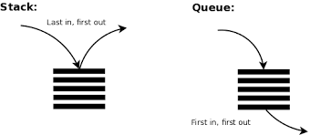
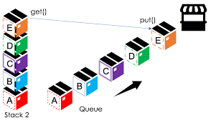
Difference Between BFS and DFS Algorithm
DFS (LIFO Principle) uses a Stack to find the shortest path.
BFS (FIFO Principle) uses a Queue to find the shortest path.

Slide 3
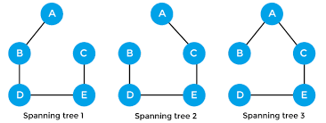
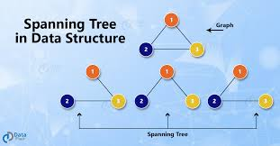
Spanning Tree
Spanning Tree is a graph without cycle or closed loop is called as a Spanning Tree.

Slide 4
Depth First Search (DFS) Algorithm
DFS traversal of a graph, that produces a Spanning Tree as a result, i.e., a graph without Lops.
DFS used as a Stack in Data Structure with maximum size is the total number of vertices in the graph to implement DFS traversal of a graph.

Slide 5
Q: Apply the DFS Algorithm on the below Graph
A
B
C
G
D
E
F
https://www.youtube.com/watch?v=UxXasZyx0Z0

